Slide 1

Job Scheduling in MiniZinc
Knowledge Representation Project – Università della Calabria
Master Degree in Artificial Intelligence and Data Science
a.y. 2021/2022

Slide 2
Job Scheduling in MiniZinc Kr Project
Job Scheduling Problems
MiniZinc Models
Java Execution Functions

Slide 3
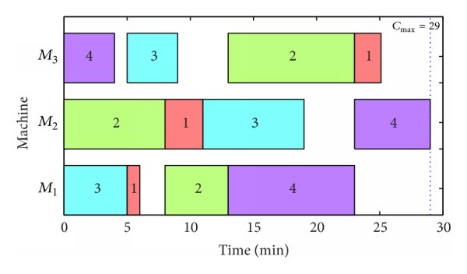
Job Scheduling Problems
Job Scheduling (JS) or Job Problem (JP) is a popular optimization problem in computer science and operational research.
This focus on assigning jobs to one or more resources or machines at particular times.
The schedule of 4 job and 3 machines.

Slide 4
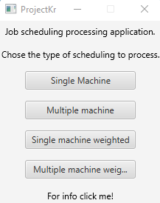
Job Scheduling Problems
There are several type of job scheduling problems.
Our application is focused on process single or multiple machine(s) problem with or without assigning weights to jobs.
In addition, the objective function aims to minimize the sum of completion times.
The home page allows users to select the type of job scheduling problem to process.

Slide 5
MiniZinc Models
Our project requires four MiniZinc models (one per type of job scheduling problem)
Single Machine Model
Single Machine with weights Model
Multiple Machines Model
Multiple Machines with weights Model
For example the jobScheduling_MultipleMachines_weights.mzn file is structured as shown in the next slide.

Slide 6
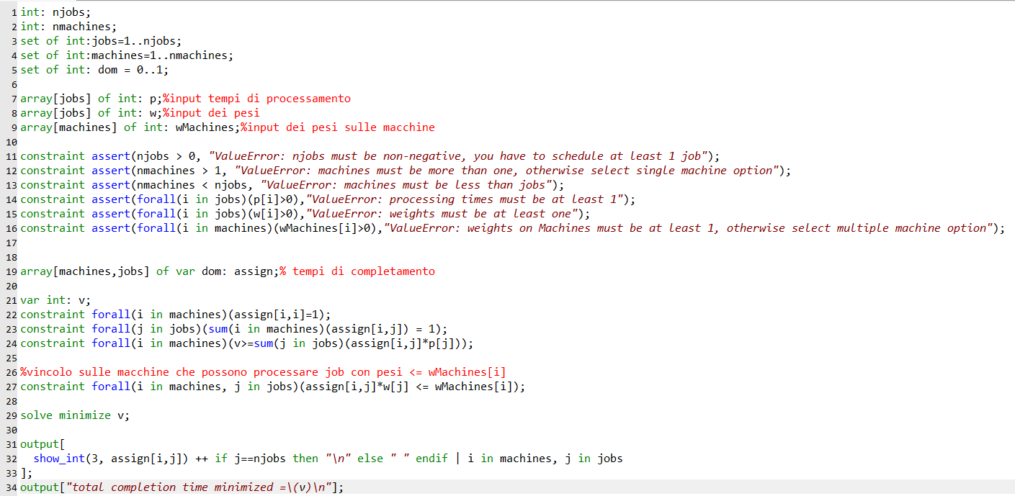
MiniZinc Models
jobScheduling_MultipleMachines_weights.mzn file

Slide 7
Java Execution Functions
To invoke the MiniZinc Solver in Java it is necessary to run a simple command line.
> Minizinc.exe -–solver Gecode filename.dzn filename.mzn

Slide 8
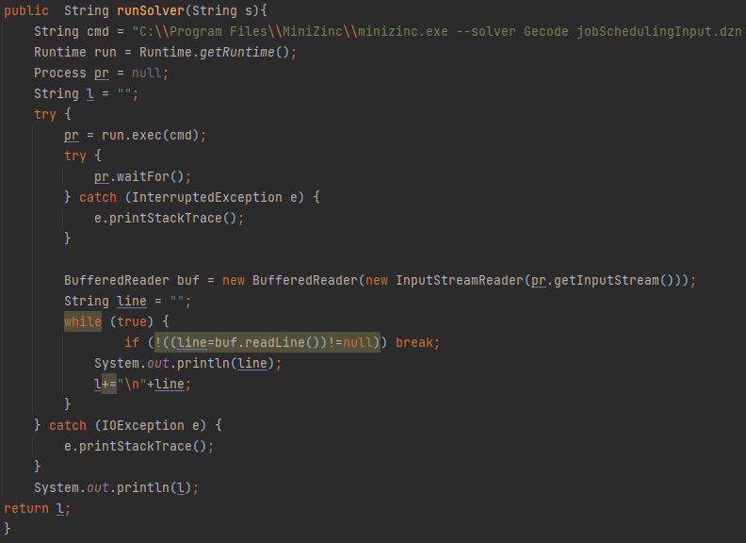
Java Execution Functions
In our code the function runSolver(String s) executes the right model in base of the matching of the type passed as parameter.

Slide 9
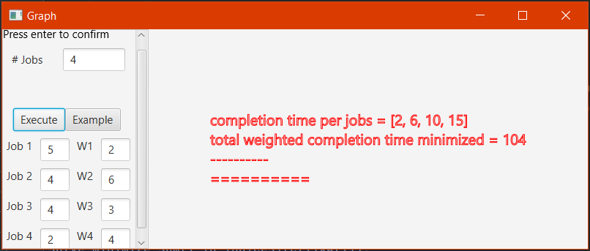
Java Execution Functions
This function is called when all the text field are filled and the user click on the button “Execute”.
In the right part of the window it is shown the output of the MiniZinc Solver.

Slide 10
Demo
To download the app:
GitHub

Slide 11
THANKS
Project and Presentation by Boca Paolo, Canonaco Martina, Fazio Francesco, Moscato Giuseppe and Passarelli Chiara.

